Slide 1

GFA - review of week 9-11
Gyula Rasztovich

Slide 2

Brief
Short introduction
Review of the recent weeks
Demonstrate one of my latest task’s solution
Closing thoughts

Slide 3
Introduction
BME - Structural Engineering MSc in civil engineering – specialization: buildings, bridges, structures
10+ years of professional experience in different fields: bridge design, project preparation, site engineering, design- and construction supervisioning, bridge inspectioning and maintenance, trading construction products
No IT experience

Slide 4
Review of week 9-11 - workshop tasks
Client and Server app
Chat program
Graphic chat application
LED matrix animation

Slide 5
Review of week 9-11 - tech background
Our recent ’buzzwords’:
init peripherals on STM32 board, such as LCD, UART, ADC, timers, GPIO ports
TCP client, TCP socket server, UDP server
winsock2.h, STM32’s lwIP libraries
RTOS
Paralel threads
2D arrays
Mutex
Message queue

Slide 6

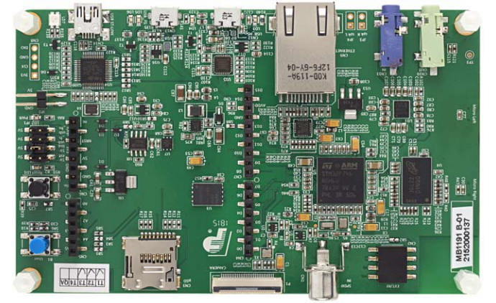
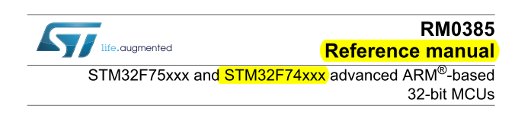

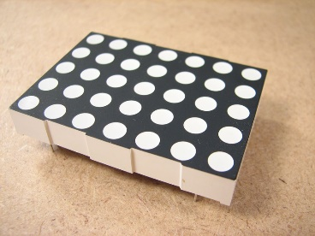
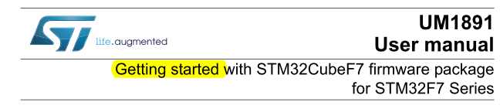
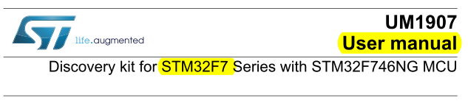
Present a project – LED matrix animation
Task: LED matrix project – create animation
Devices:
STM32F746NG-Discovery board
LED matrix
Breadboards, cables, resistors, potentiometer
Available hints for the project:
A few TODO directions
Data sheet of LED matrix device
Thousands of pages of STM board
Billions of pages of internet ☺

Slide 7
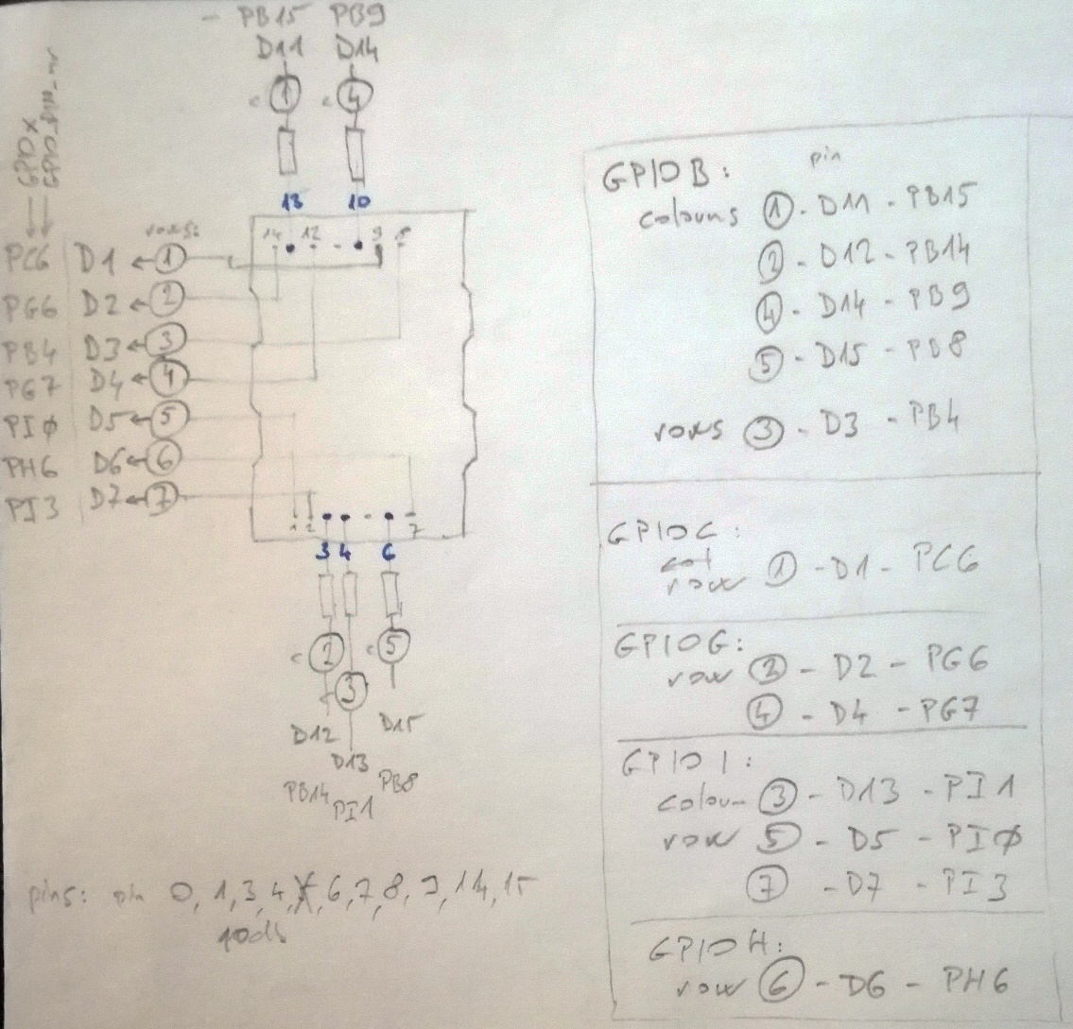
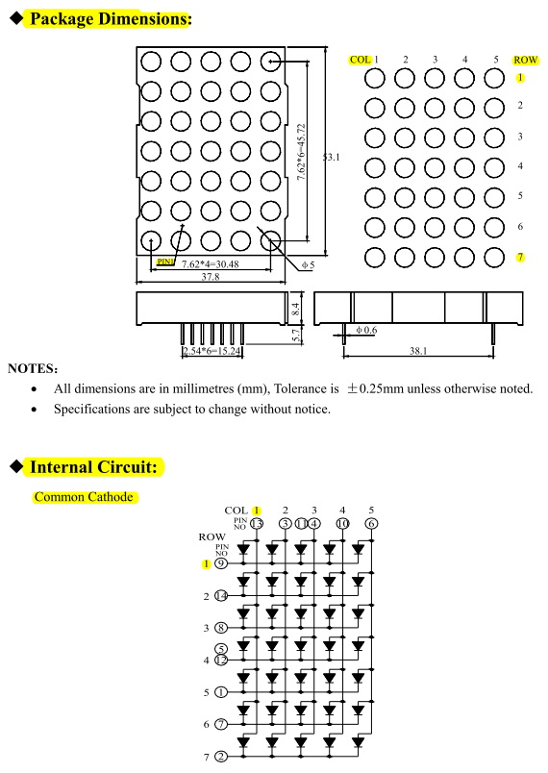
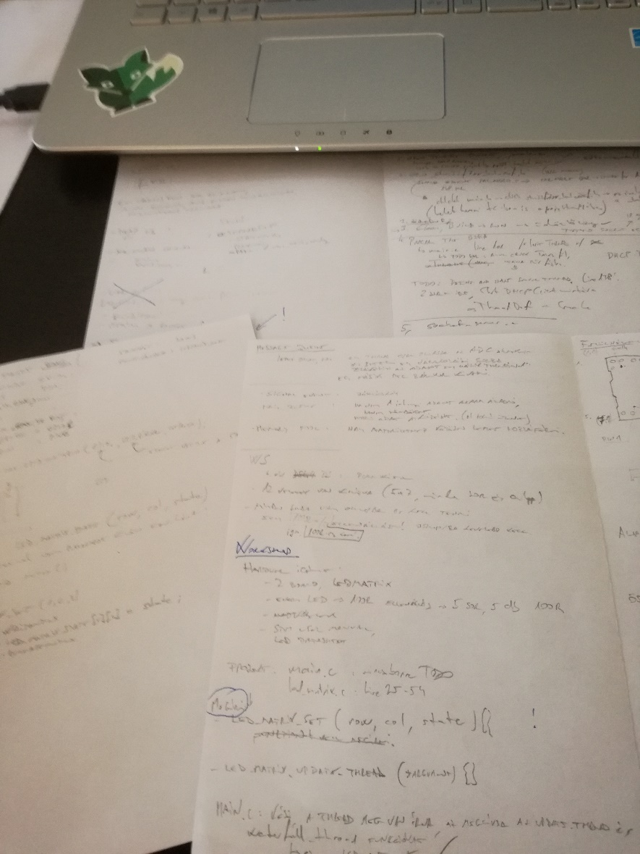
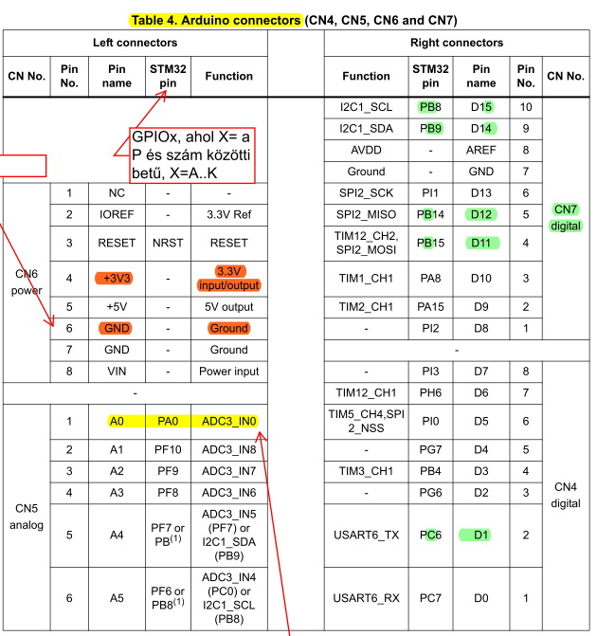
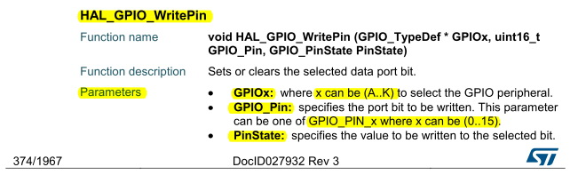
Present LED matrix project – my solution
Pre-design
understand the task,
panic!
have a coffee,
search for hints,
making notes,
design the circuit diagram,
define the main phases of realization,
collect the necessary HAL and BSP and template files,
summarize which subtasks are needed.

Slide 8
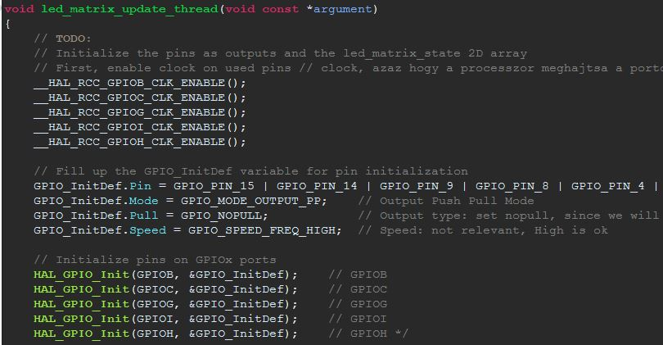
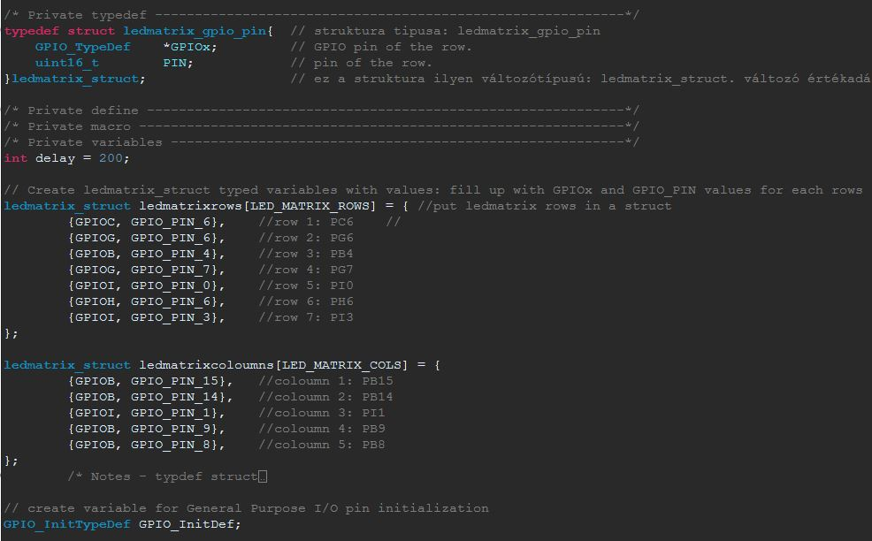
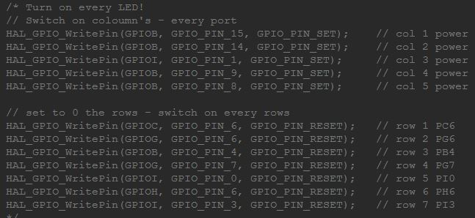
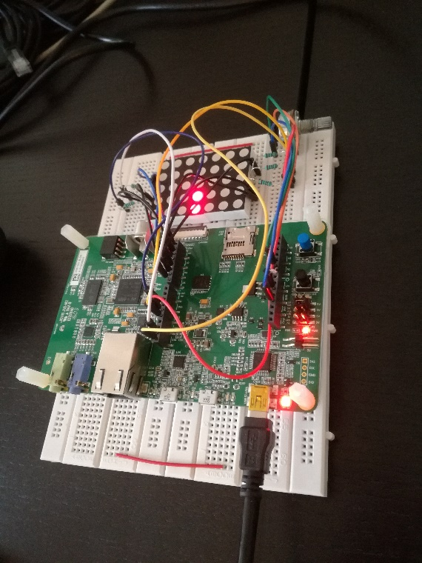
Present LED matrix project – my solution
Execution – first steps
drink another coffee ☺
create the hardware – connect the tables
create the private variables (and variable types)
init clock, init pins and ports, write a simple task with no need of extras
test! -> it does not run → panic!
No more coffee, I just had two cups, need another kind of magic → THINK!
find problem /* of course it was ridiculous */ -> yess! something is running!
comment my mistakes!

Slide 9
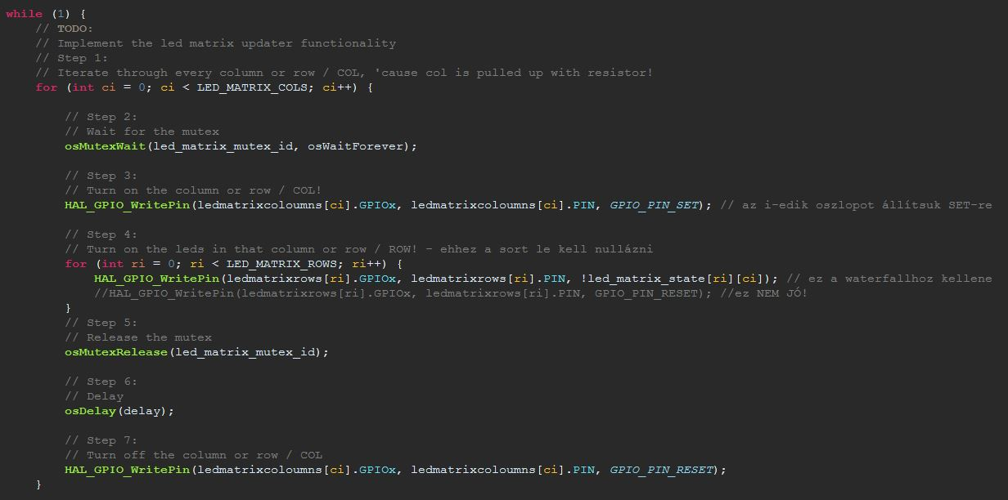
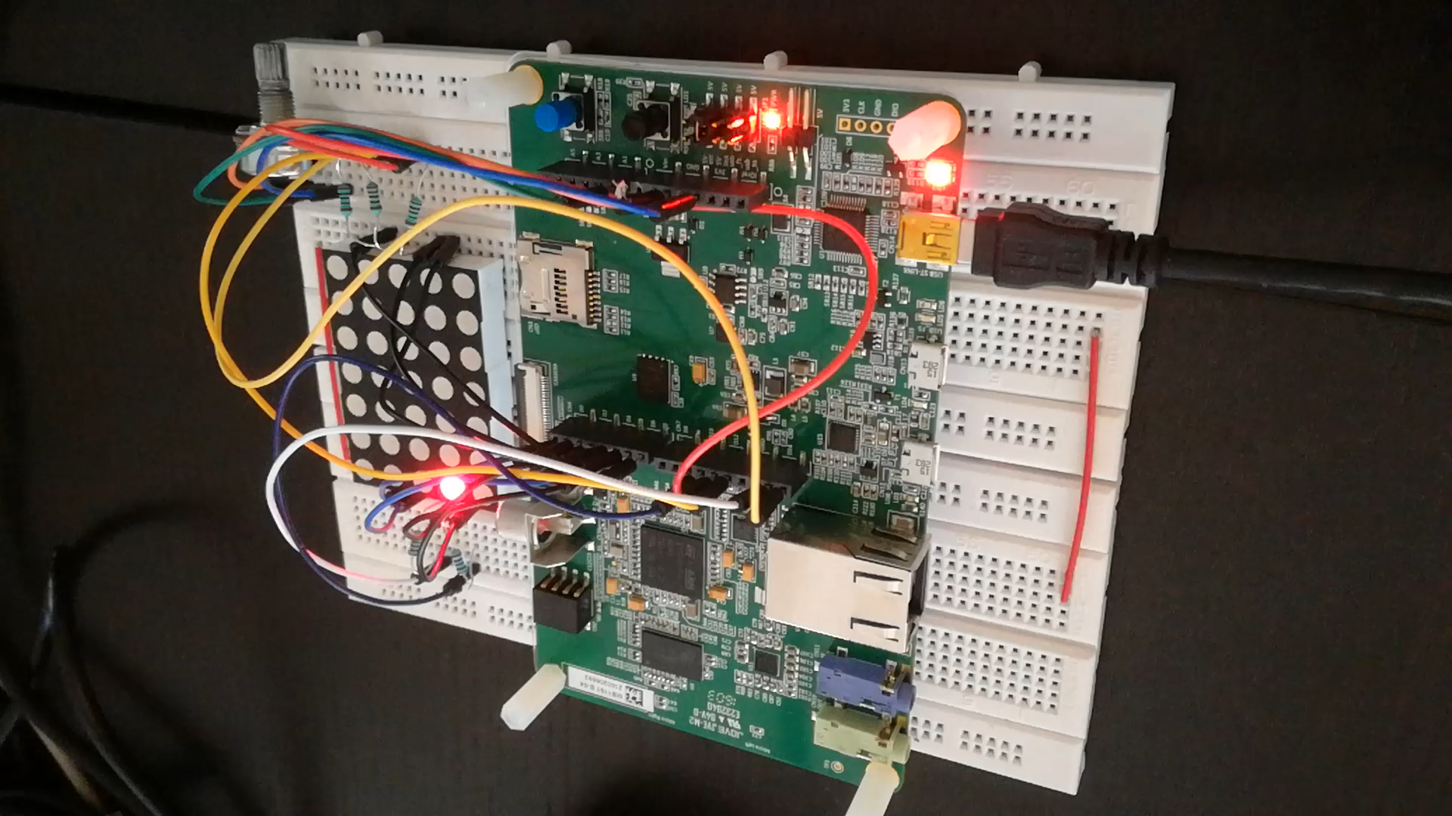
Present LED matrix project – my solution
Execution – fine tuning
create mutexes,
write loops,
use 2D array to make possible the animation,
nice job, high-five congrat is deserved ☺

Slide 10
Closing thoughts
Try to work alone as far as it’s reasonable!
Push yourself – the solution might be close!
Be persistive to find hints!
Think and tunderstand the missing parts, implement it consciously!
If you stuck, ask a pro!
Can be useful to cooperate with similar-trained collegaues – they might already met the same problems/walls like you!
Make notes, templates, example-libraries, comments – you will thank yourself later!

Slide 11
Thank you for your attention!

